Slide 1
ONLINE RETAIL ANALYSIS.
Forage [TATA]

Slide 2
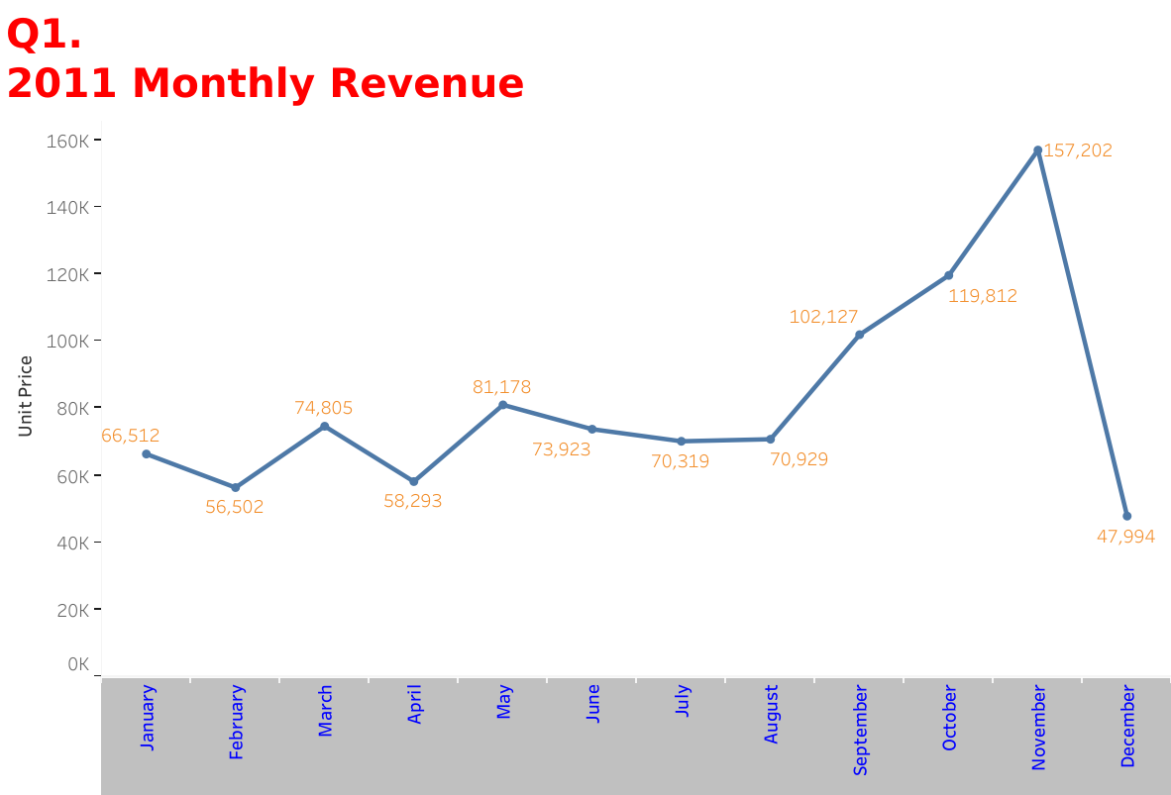

Slide 3
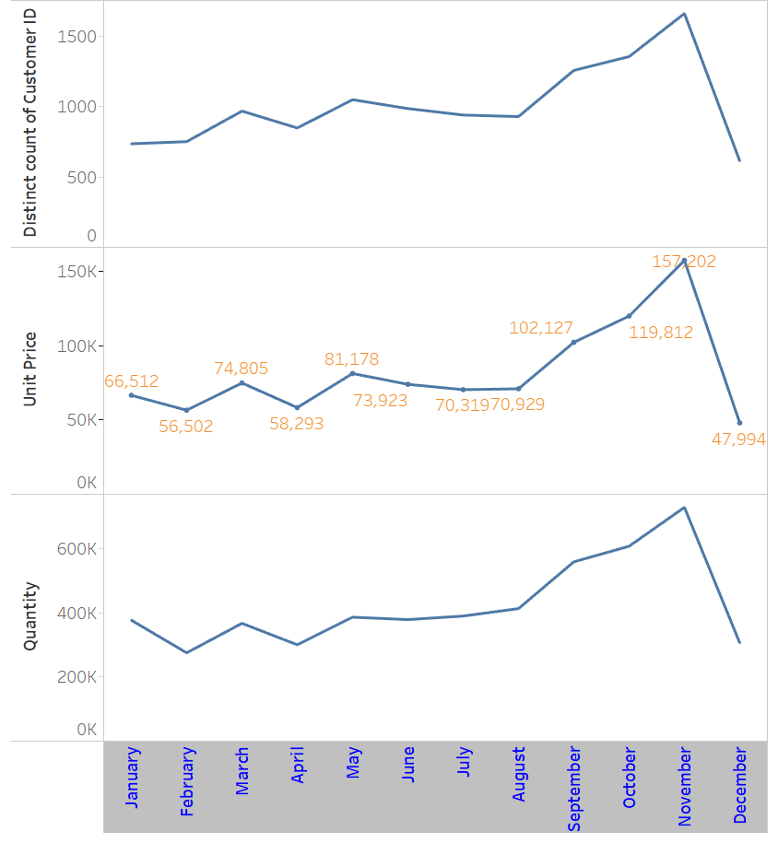

Slide 4
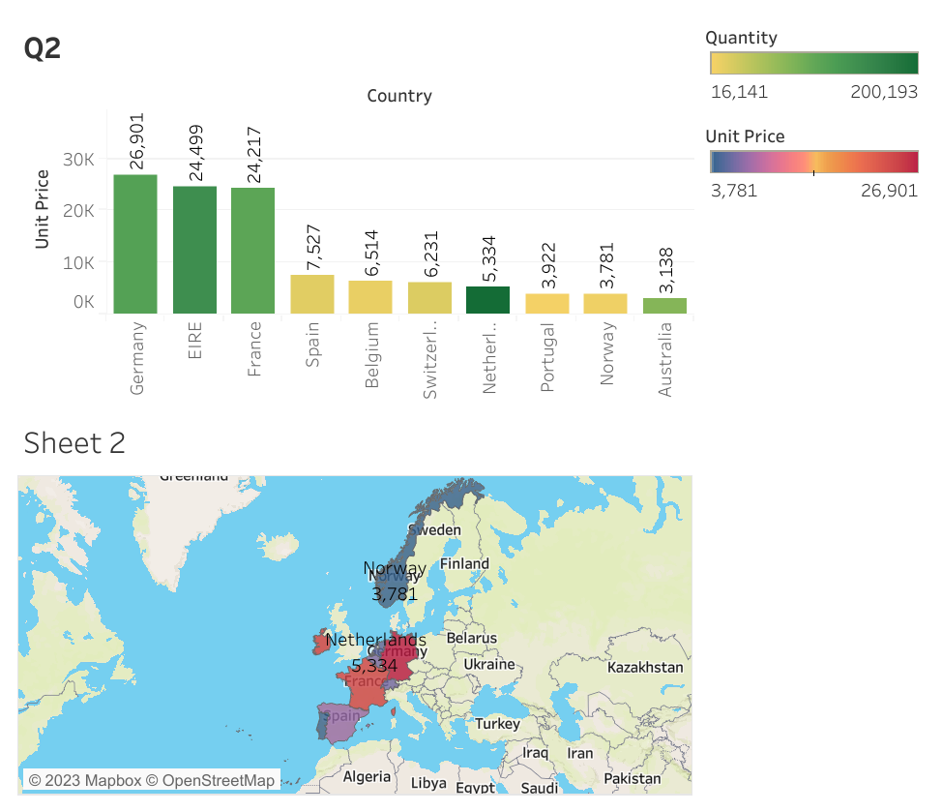

Slide 5
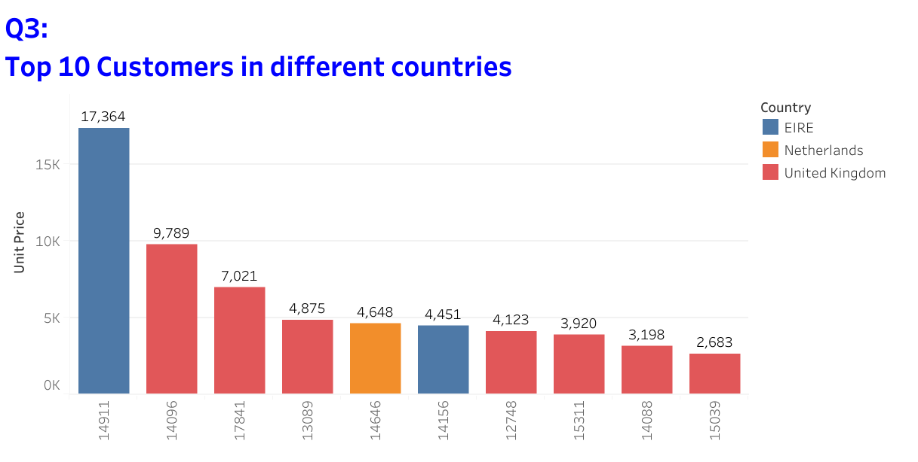

Slide 6
